Slide 1
DITA Topic-Based Writing

Slide 2
Session results
Content is King – Foundation Pyramid
Concise Writing – quick review
Task-oriented Writing – quick review
Topics Types – relationship with concise and task-oriented writing
Topic-based Writing (DITA)
Topic-based Writing – Organizational Steps
Summary tasks – How they look in DITA
Task Analysis Questions
Task Substeps
Task Substeps – How they look in DITA

Slide 3
Content is king – Build the foundation
Topic-Based Writing
Task-Oriented Writing
Concise Writing
Facts
Quality content takes longer to write
Quality of legacy content must be elevated/reworked
You must make a conscious effort to write this way

Slide 4
Concise writing
RRAA
Remove
Replace
Avoid
Affirm
Summary
For the writer: when in doubt, leave it out!
For the peer reviewer: when in doubt, take it out!
Notes:
RRAA, or RARA, or AARR!

Slide 5
Task-orientation
Keep focus on REAL tasks
Use headings that reveal the task
Optimize task structure
Keep task focus down to lowest level step

Slide 6
Topic types review
Concept
describes why and what
Task
describes how to perform a task
Reference
provides details necessary to make decisions
Procedural− Typically involves numbered steps
Descriptions − What does this button do? What does this acronym mean?
Justification − Why do I need this info?
Task steps − How do I complete my task?
High-level process − What do I do next?
Navigation − Am I on the right page?
Features & Limitations − Can I save this information?
Goals − What can I do with this application?
Examples − What's a good password?
Exceptions − What if I have two middle names?
Relationships and dependencies − How do these settings relate to each other?
Expectations − How long will this take?

Slide 7
Topic-based writing (DITA)
We know
Narratives work well for books, but not for technical content
Technical content is not read from cover to cover – it is read by topic
Users have a specific goal - Want to find a specific task, complete it, and move on
Topic-Based Writing Benefits
Topics can be reused (write quality content once)
Users scan and find information more quickly
More productivity – Each writer can contribute specific topics that support user goals
Collaborative product releases
Organize and reorganize content more easily
Reviewers review chunks of content – not the whole deliverable

Slide 8
Topic-Based Writing – Organization in four Steps
Get Organized – Four Steps
Determine the goals that the user needs to accomplish
Start with the task topics
Add the concept topics
Add the reference topics

Slide 9
Step 1 - Let’s practice goals
We’ll start easy and get harder:
Band aid
Toothbrush
iPhone

Slide 10
Step 2 thru 4 – Start with task topics, add concept topics, and add reference topics
Let’s go back to example from a previous session week:
Goal – Migrating the software to the new version
Tasks – List all the task topics
Concepts – List and add the concept topics
Reference – List and add the reference topics

Slide 11
Result – How does this look in DITA?
Goal: Migrating the Software to the New Version
Task Overview - Original | Summary Task - Revision
Hardware requirements Software requirements Applying updates Stopping Processes Backing up your Process file Running the utility for Windows Running the utility for UNIX Verifying migration Setting up a new profile What’s the order of steps here and what’s the process? Which of these are concepts and which of these are tasks? Read the goal, as a user do you know how to accomplish this goal from the information above? | Verify that you have the correct hardware and software: Hardware requirements Software requirements Apply updates. Stop Processes. Back up the Process file. Run the migration utility: On Windows On UNIX Verify the migration. Set up a new profile.

Slide 12
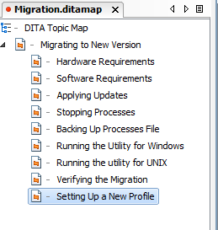
What about this?
Ditamap organization for this process
You can reuse the hardware and software topics anywhere you would like
Let’s take a look at the topics

Slide 13
DITA Best Practices Book – Task analysis questions
Task Analysis Questions
What is the Goal?
What tasks does the user need to do to accomplish the goal?
What are the mental and physical steps involved in each task?
Who performs the task?
When and under what conditions is the task performed?
What are the potential distractions to accomplishing the goal?
What does the user need to know about the task?
What is the sequence of tasks for steps?
What is the expected result?

Slide 14
Substeps in tasks- Improved usability
Original | Revision
To add a setting to your profile: Select the profile you want and right-click. Select Properties from the menu. In the Properties window, find the name of the profile file. Close the Properties window. Open the profile file in a text editor. Add the setting to your profile. Save the profile. Run the profile command. | To add a setting to your profile: Determine the name of the profile Right-click the profile that you want and select Properties from the menu. In the Properties window, find the name of the profile file. Update the profile file with the new setting: Open the profile file in a text editor. Add the setting to your. Save the profile. Run the profile command.
Notes:
V2. shows relationships of some steps to each other, makes it easier to scan. Note that the more usable version is not always shorter!

Slide 15
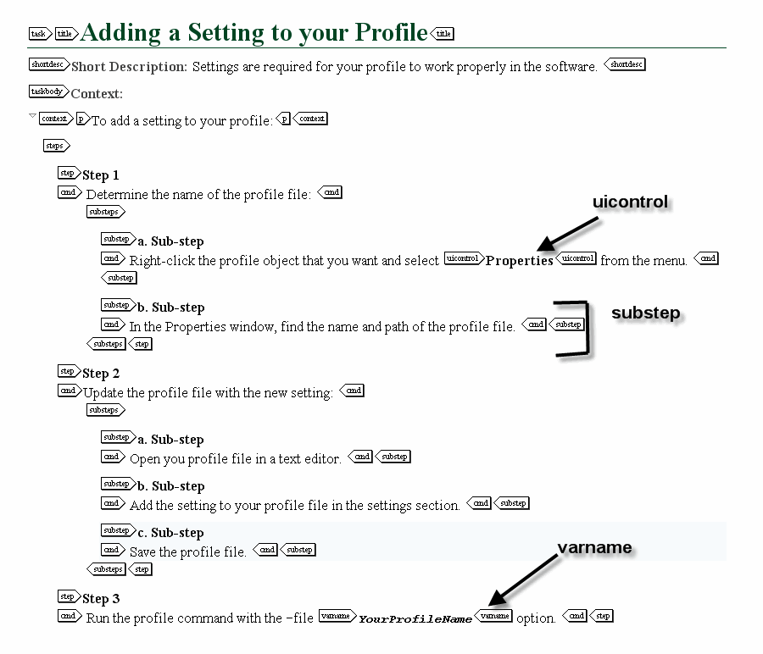
Result – How does this look in DITA?

Slide 16
Session results – Where we’ve been
Content is King – Foundation Pyramid
Concise Writing – quick review
Task-oriented Writing – quick review
Topics Types – relationship with concise and task-oriented writing
Topic-based Writing (DITA)
Topic-based Writing – Organizational Steps
Summary tasks – How they look in DITA
Task Analysis Questions
Task Substeps
Task Substeps – How they look in DITA

Slide 17
Think about
When working on projects:
Implement concise writing – start now
Practice task-oriented writing – start now
If you were working in DITA, think about what you would do?

